Slide 1
Coding Club Meeting 1

Slide 2
Goals for this meeting
Create a GitHub account and gain access to the Coding Club Repository
Install Scratch and become familiar with the program
Push a sprite from your own project to the Coding Club Repository

Slide 3
Basics of GitHub
Before we start our first project, lets go over where we are going to save and share our code to. Here’s some background on the website GitHub, which we will be using as a club to work on projects together
Git is an open source software used for tracking changes in any set of files. This is particularly useful for making and editing code, and is usually used for coordinating work among programmers collaboratively.
GitHub is a service that uses git, and stores saved files on a cloud server.
Best used from the command line, GitHub allows a user to easily store data and every iteration of a code or other file. This works by having a user upload, or “Push” files to their storage locations, or repositories. Additionally, users can “Pull” files from the repository to update files on the computer
What makes this so useful is that Git will recognize files of the same name and know that these files are the same file. The program will overwrite the old one but save the past iteration in a “tree” or file history.
Though this functionality is very useful, for now we will just be using GitHub through the website and manually uploading files.

Slide 4
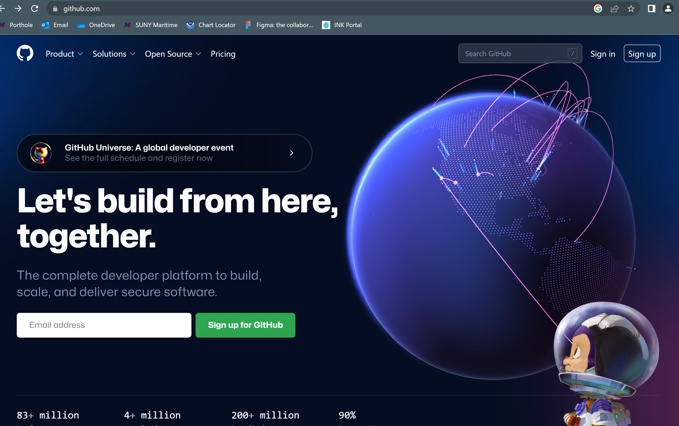
Signing Up for GitHub
GitHub is a service that uses git, and stores saved files on a cloud server.
To get GitHub, first go to https://github.com/
Click “Sign Up” at the top right corner
Follow the Prompt and input your relevant information to create your account

Slide 5
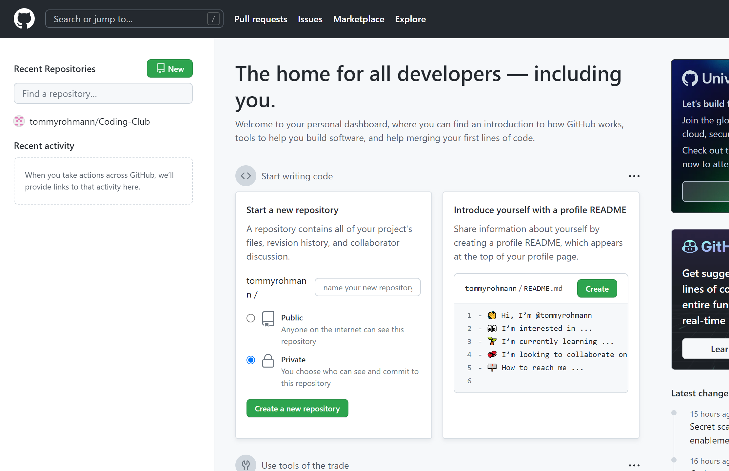
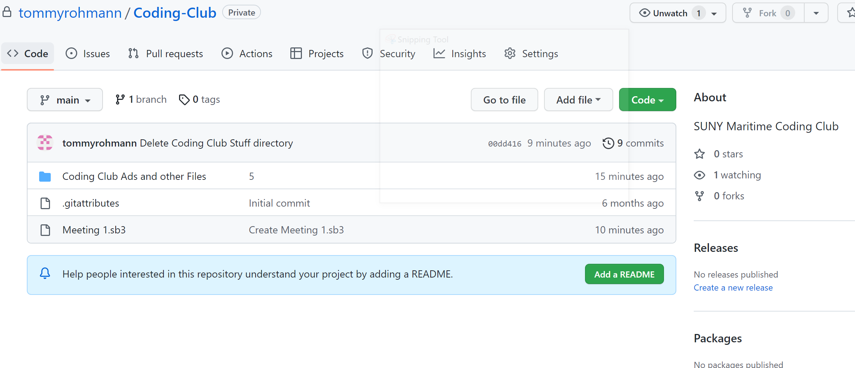
Using GitHub
GitHub is best used through a computers terminal, but for now we will just be navigating the website. From the home page you can see all of your saved repositories and options to make new repositories.
You can also access other repositories through GitHub. Example being the Coding Club Repository: https://github.com/tommyrohmann/Coding-Club

Slide 6
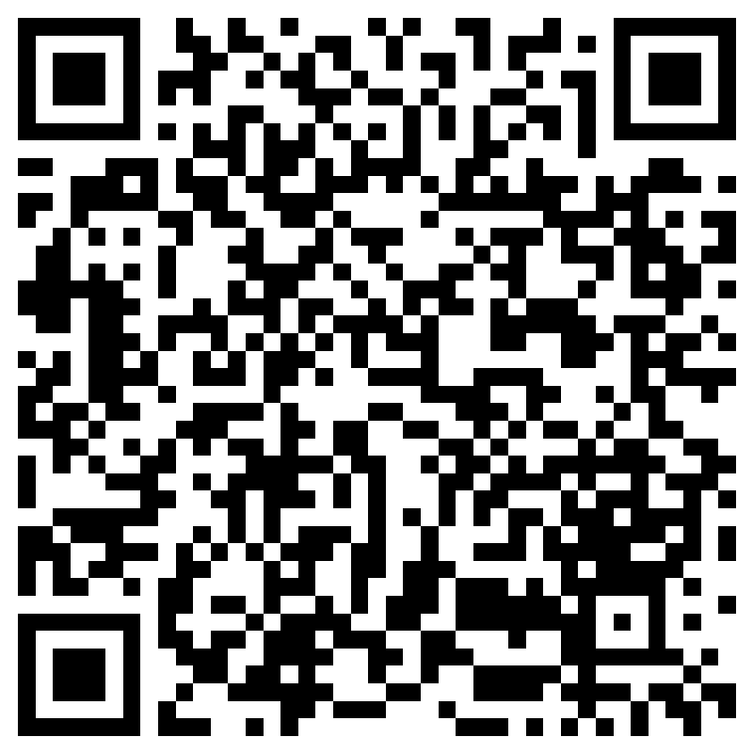
Using GitHub
In the coding club, we will be working collaboratively on one repository. To become a collaborator on the Coding Club Repository, send your GitHub Username to this form.
Coding Club Repository: https://github.com/tommyrohmann/Coding-Club
Or follow the link:
https://forms.office.com/Pages/ResponsePage.aspx?id=VGZw_NSNrUO32IhD8WGXXigPwIXu8JZHuKz_ckepTQJUNVJNQko2TjJHSlBNSVJZNUxJSDFOVklENS4u
From here you will have to be invited by the Repository Owner (The club President). Once Invited and accepted you can access the Coding Club Repository from GitHub as a collaborator. Without this, uploading files will not be possible.

Slide 7
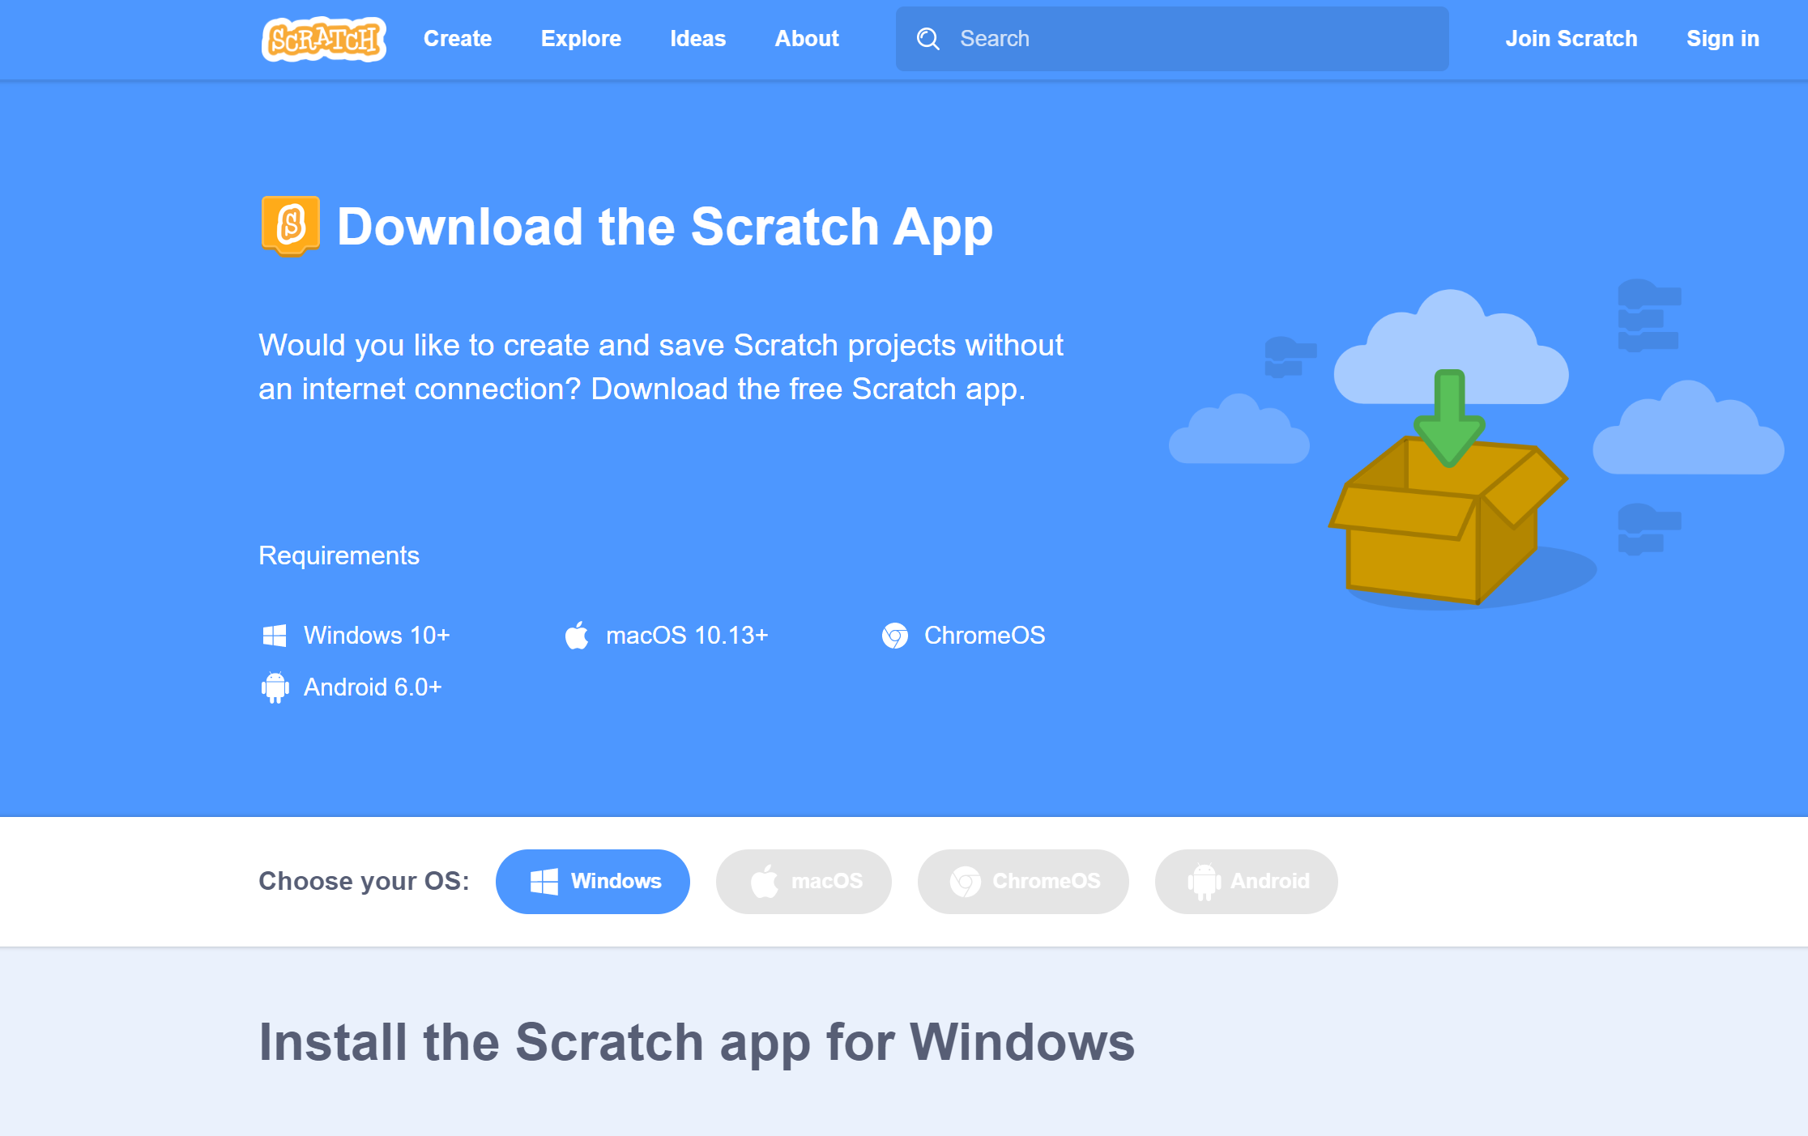
Joining and Downloading Scratch
Scratch is a “Block Coding” program used to educate on the basic principles of programming. The program has in online editor, but since we will be working outside of the Scratch website, we will be installing the program. To do this, navigate to https://scratch.mit.edu/download
From here select your operating system and download the installer. When downloaded, run the installer and open scratch.

Slide 8
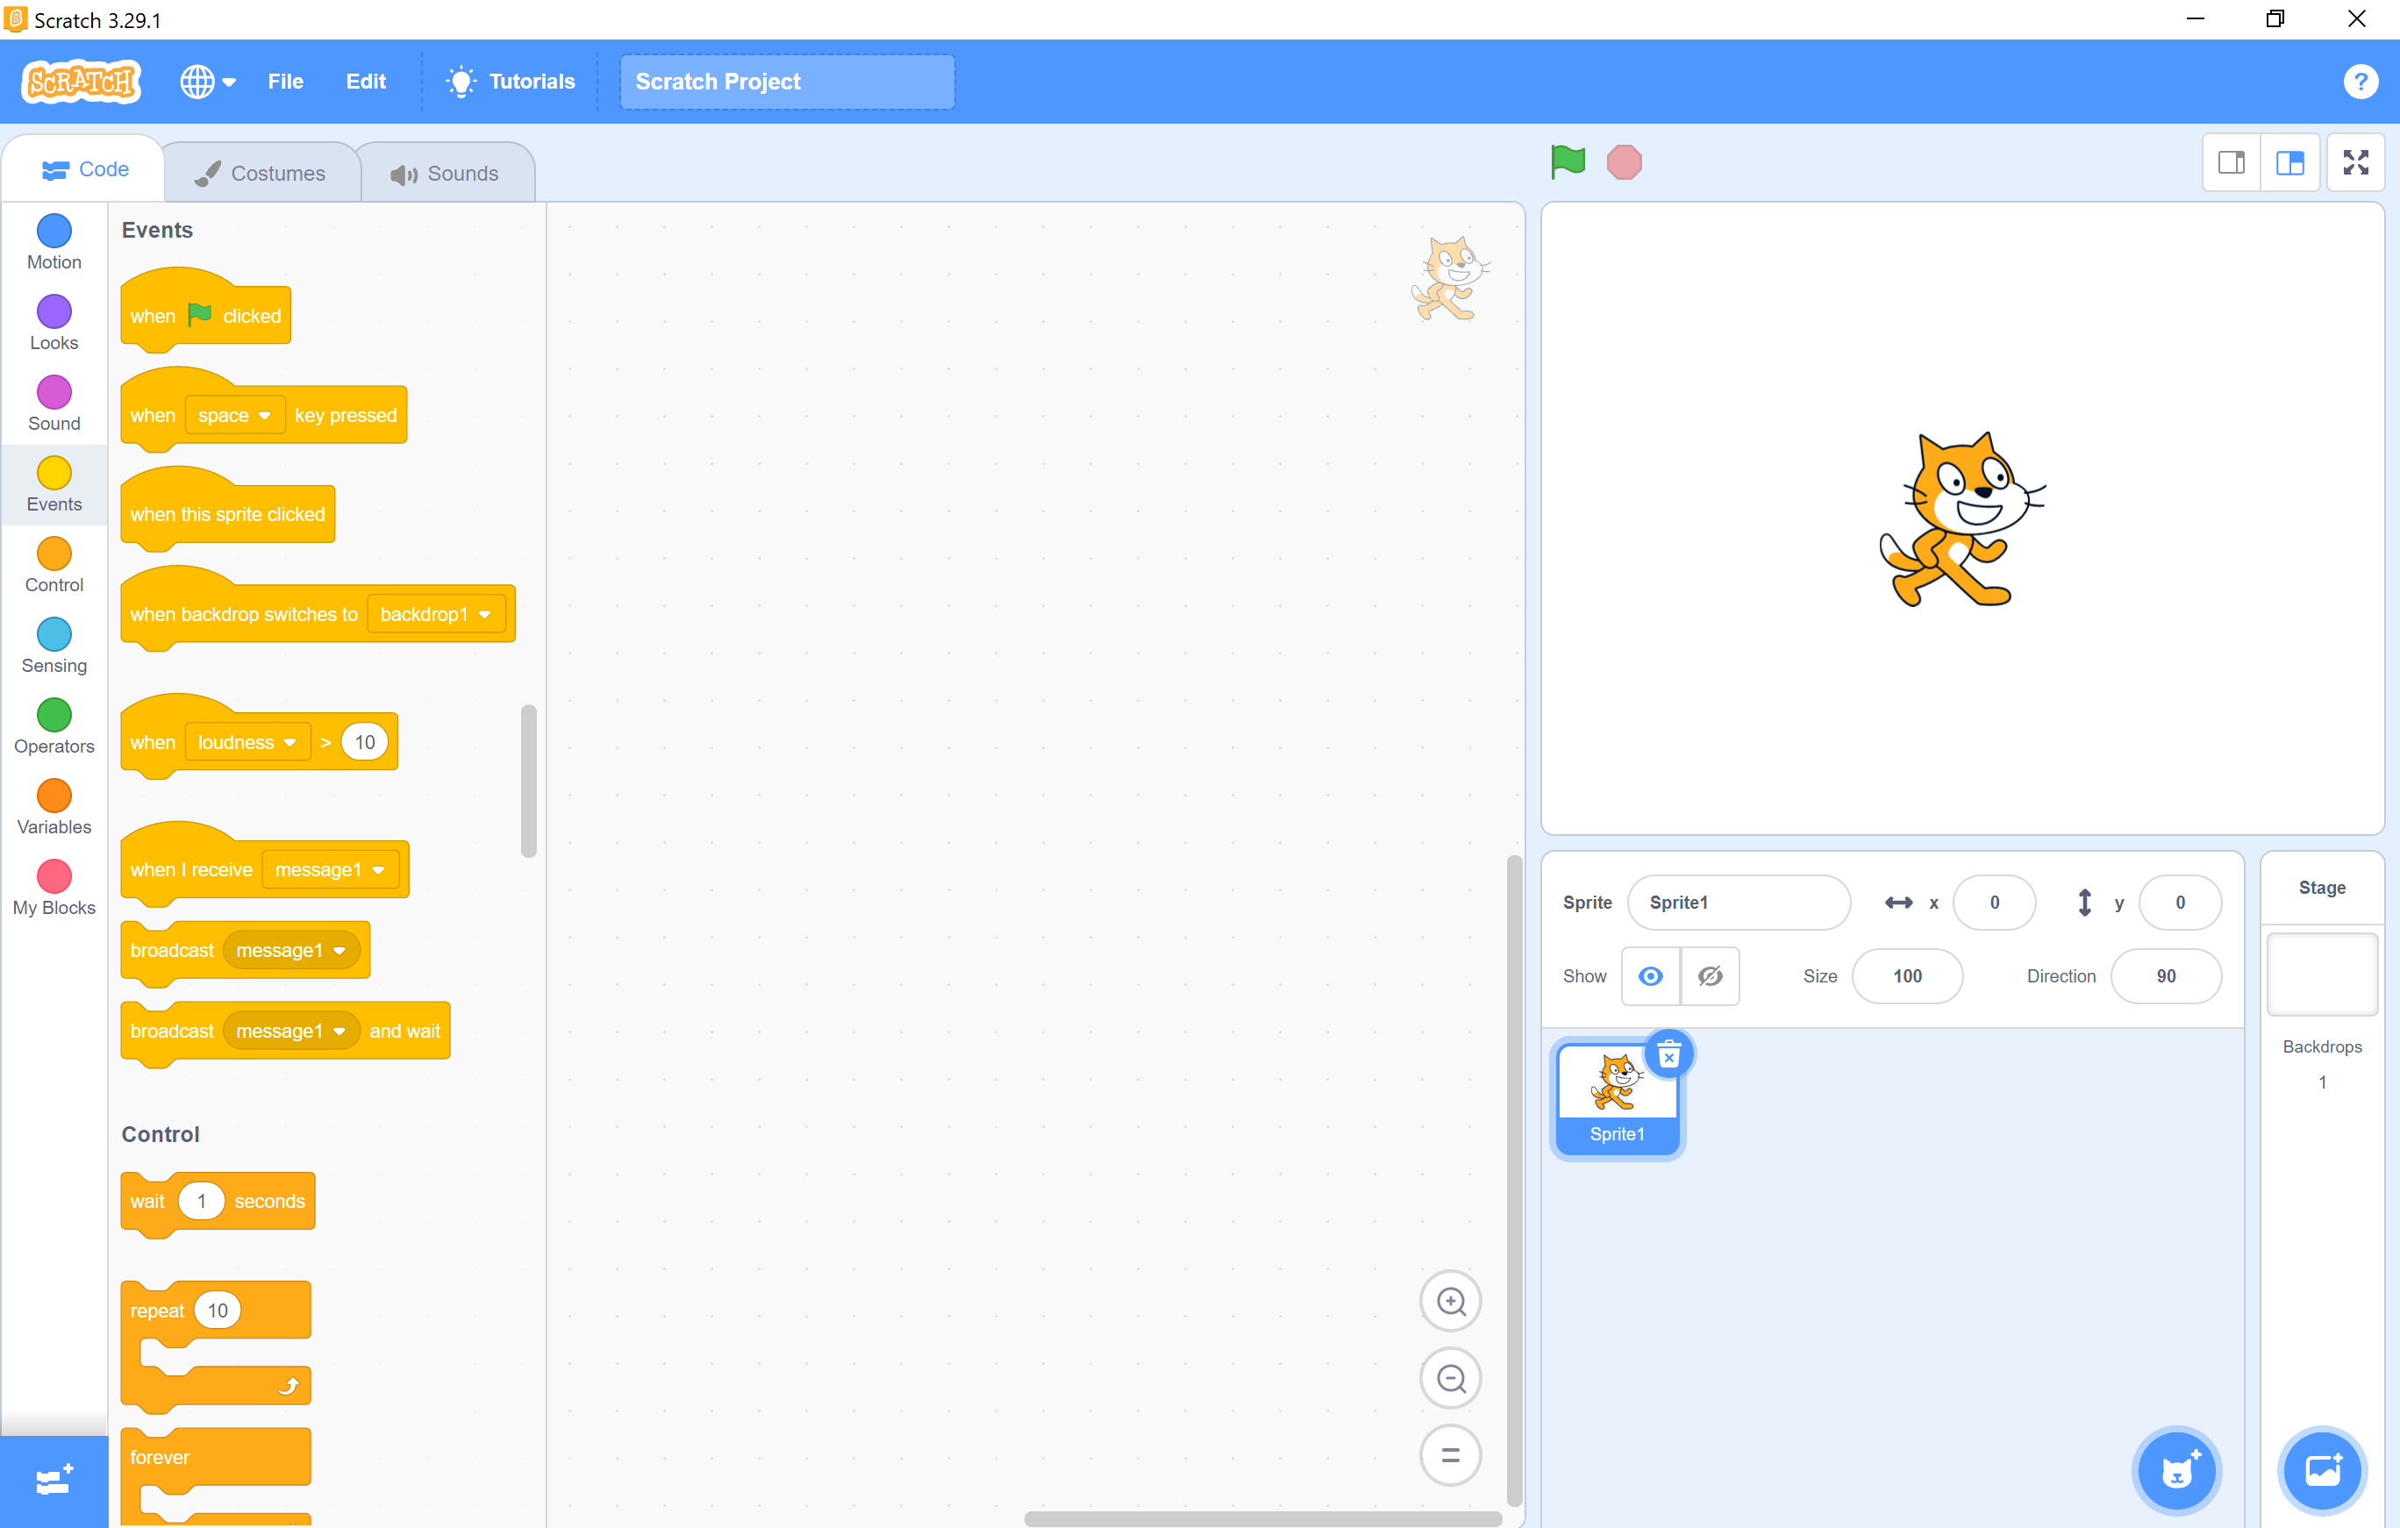
Scratch Basics
With Scratch open, you can see the program layout.
A
B
D
C
E
F
G
A: Options and File Management (View the tabs “Code”, “Costumes”, and “Sounds”
B: Scripts, Costumes, and Sounds Pages
C: Sprite Code (Where the code you make will be)
D: Stage (Where sprites exist and carry out your code)
E: Sprite Info Sheet
F: Sprites and Stage Menu
G: Add libraries (Additional functionality for your code)

Slide 9
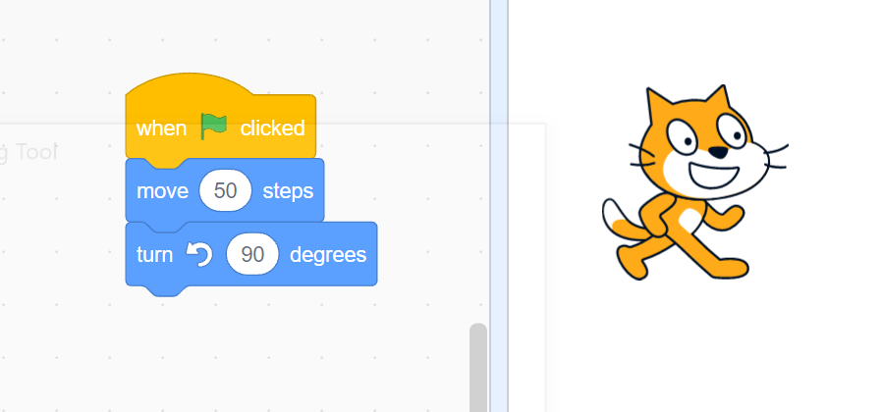
Scratch Basics
In Scratch, objects, called sprites, have certain attributes and relationships to other sprites which you can control through the code you make (Object Oriented Coding)
Through the use of the available blocks, you can make video games, user interfaces, animations, and much more.
Coding in Scratch:
Much like any other code, the code a sprite follows is a set of instructions which the sprite will carry out in a certain order. In scratch, a code is initiated, and the computer will execute the code from the top down.
Shown below is a code for making the sprite “Move 50 Steps” and then turn 90 degrees. The code is inially started through an event which in this case is the user clicking on the “Green Flag” or start button.
Green Flag starts code
Order code is executed

Slide 10
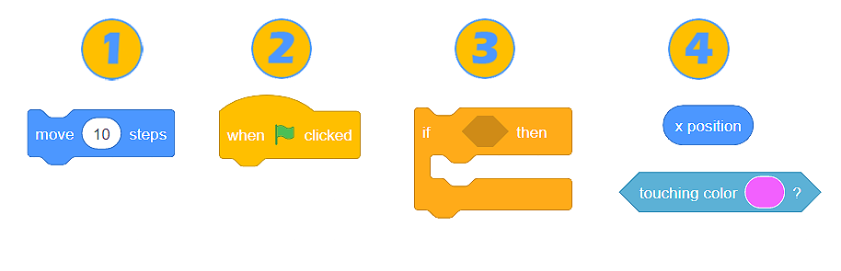
What the Code Blocks Do
There are 4 types of blocks in scratch:
1) Stack Blocks:
Parts of the code that do something. They may have inputs which can be typed or taken from a sensing value/variable
2) Hat Blocks:
Initiate a code starting, triggered by an event
3) C Blocks:
Either loops or if statements, these blocks control a code repeating or not being
4) Reporter Blocks:
Read off a value, they can be on a sensor or a stored variable. They fit into other blocks to control functionality
Other) Cap blocks:
These blocks will end a code, but are not used very often Since a code will end once it reaches the end of a stack, but can be used in some situations such as to end loops

Slide 11
What the Code Blocks Do
These blocks are categorized by what they do, so navigating the menu to find the blocks you need is rather easy. Following the selection menu, generally the functionality of the blocks is as follows:
Control and handle the movement of a sprite on the stage
Controls the appearance/visual attributes of a sprite
Sound blocks if desired for a project
Events that might trigger and initiate a given code
C blocks that manipulate the order which code is executed
Sensing blocks that output values or Boolean (True/False) to be read and used by other blocks
Math for reporting blocks
Stores values to be used later, also includes lists
Custom blocks that perform a function that you define by scratch code

Slide 12
What Code Blocks Do
For more info on how these blocks work, follow the link to the wiki:
https://en.scratch-wiki.info/wiki/Blocks
For ideas of what can be done with scratch, check out some projects posted on the website:
https://scratch.mit.edu/
Or look up some YouTube videos, some cool projects posted on YouTube might include:
https://www.youtube.com/watch?v=lexzguOQCS0
https://www.youtube.com/watch?v=IRFsSUON4KQ
https://www.youtube.com/watch?v=hf3wWPJ3ttc

Slide 13
First Scratch Project
Alright, so we have Scratch now, we have a GitHub Account, and are collaborators on the Coding Club Repository, lets start a project.
(Note: You do NOT need to be a collaborator to download the base file and use scratch, you can do this activity up until you would add a file to the repository without being a collaborator)
For todays meeting you can access a scratch (SB3 File) called “Meeting 1” in the Coding Club Repository: https://github.com/tommyrohmann/Coding-Club
Download the file and note the files location
Note: do not download the entire repository, this may cause some problems

Slide 14
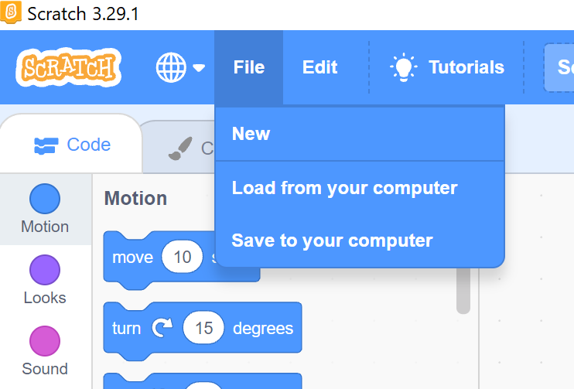
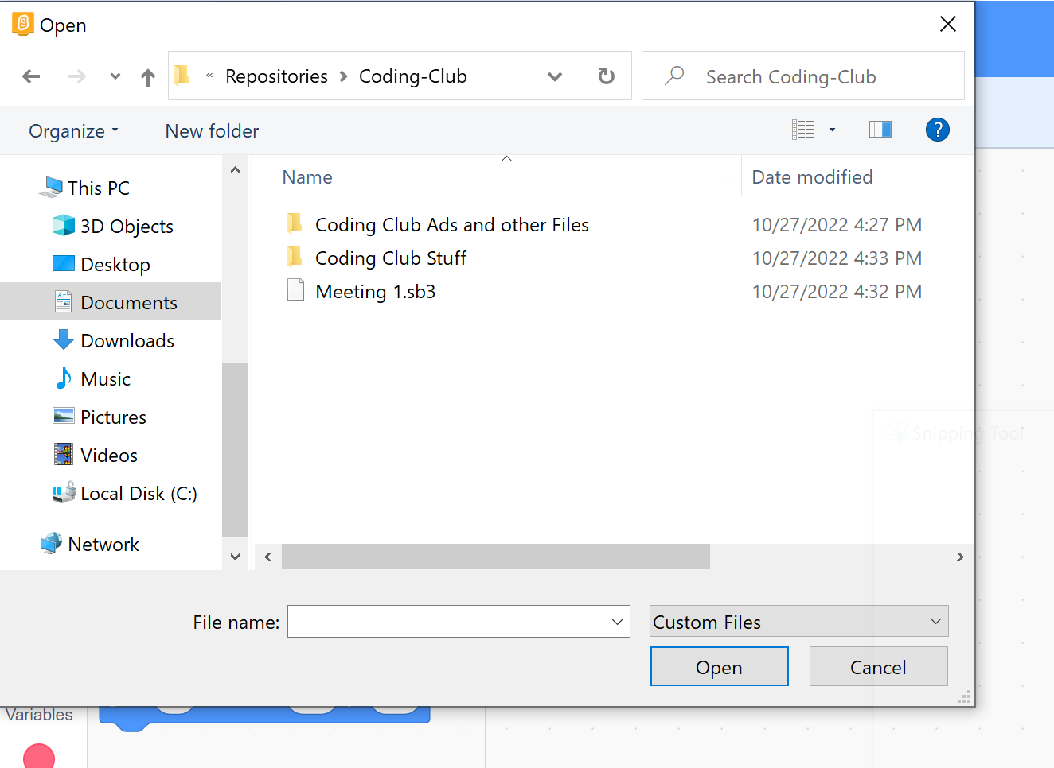
First Scratch Project
Lets start by opening the file we just downloaded in scratch. Lets Start by opening Scratch and then going to FILE -> Load from your computer
Navigate to where the file “Meeting 1” was downloaded to, select the file, and open it.

Slide 15
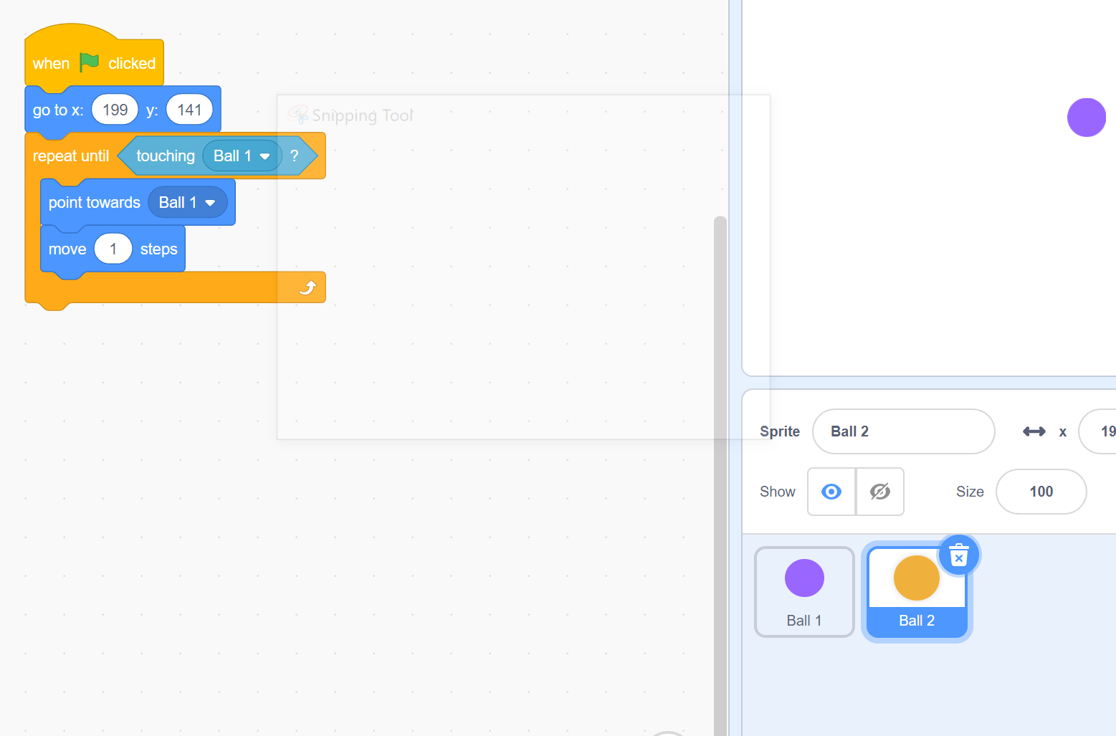
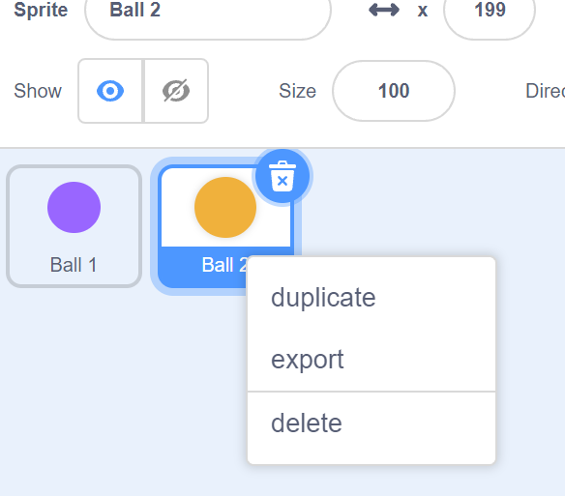
First Scratch Project
With the code open, lets look at what it does. It has 2 sprites, Ball 1 and Ball 2. These sprites each have a code initiated when the green flag is pressed. While ball 1 will go to a fixed location and stop, Ball 2 will point towards the other ball, and move in that direction until the two balls are touching.
For this project, try to edit the code so that the way Ball 2 meets up with Ball 1 is different.
Once you have this new code, we will try to export the sprite Ball 2. To do this, right click the sprite, to reveal the sprite options menu, click export sprite, choose a location to save the sprite, and then name it whatever your username is
Example: My GitHub is tommyrohmann,
So I named my sprite tommyrohmann
When I exported it

Slide 16
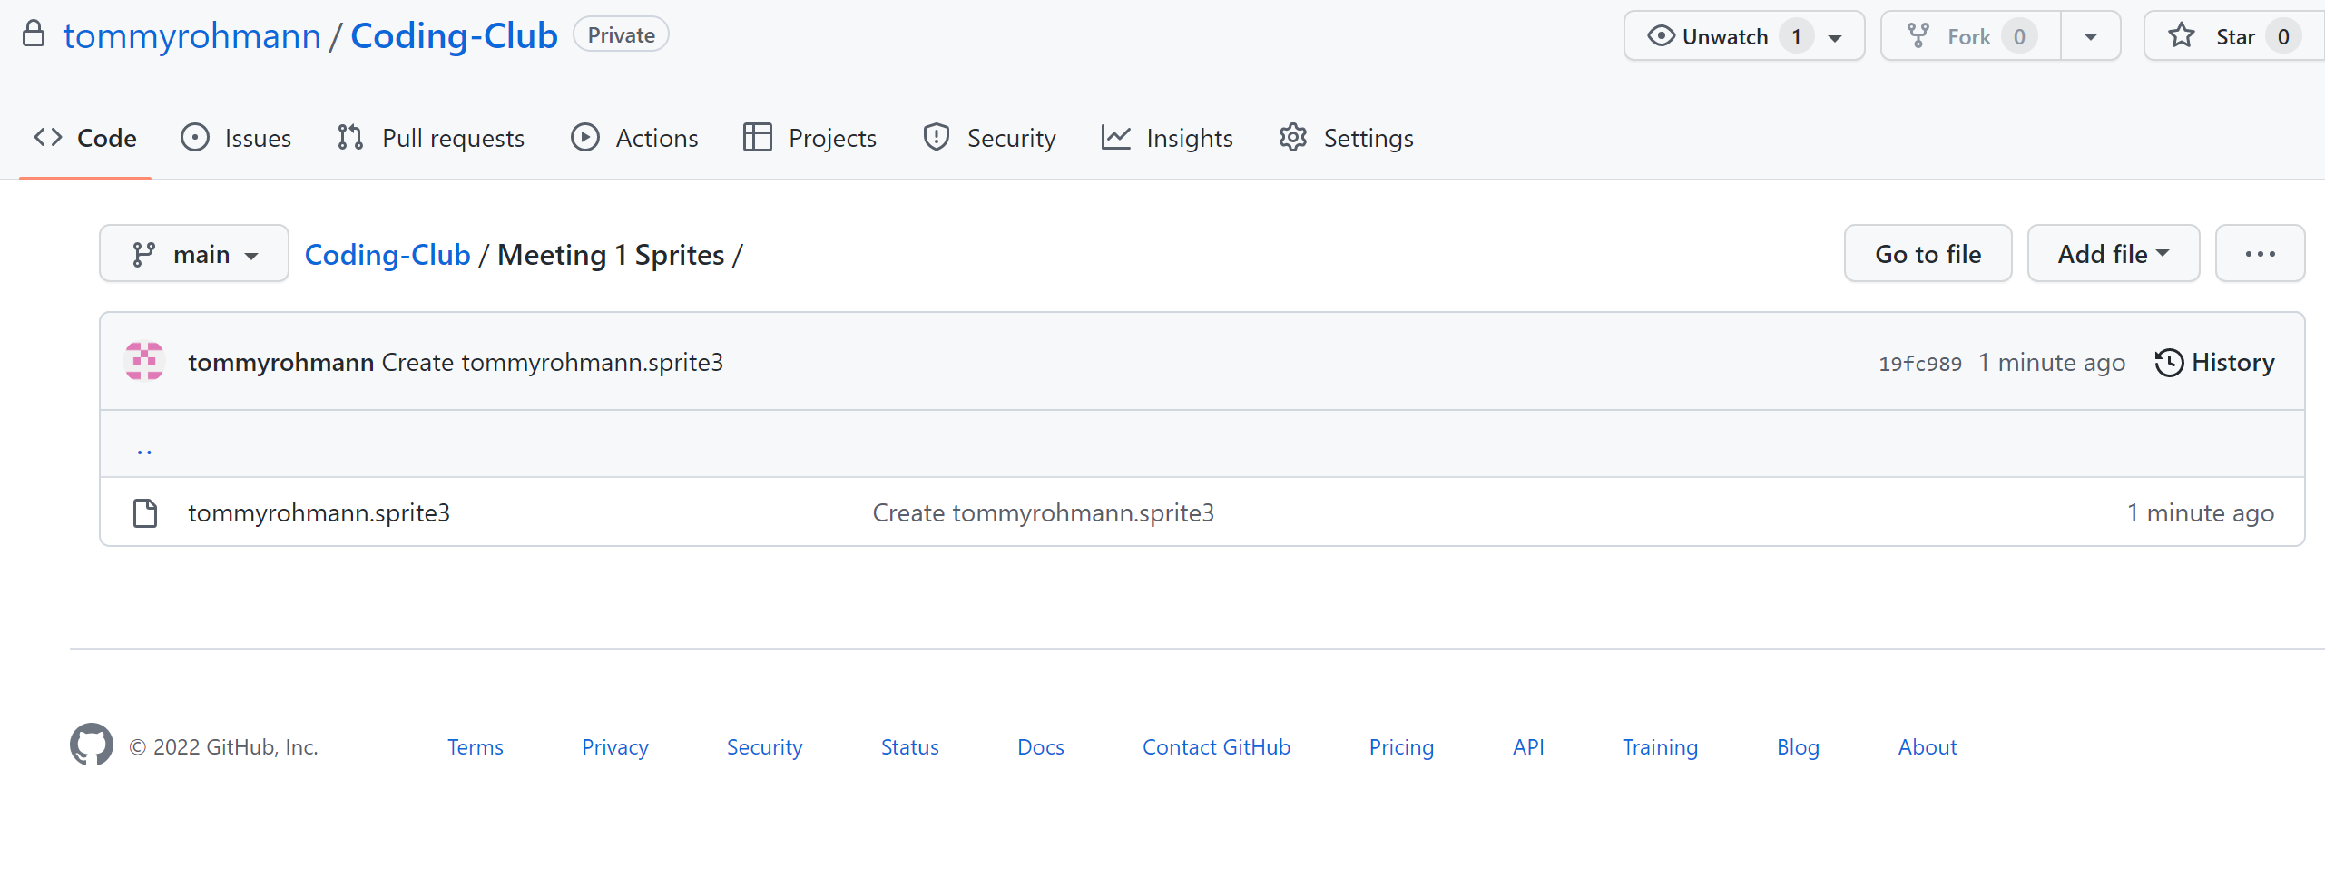
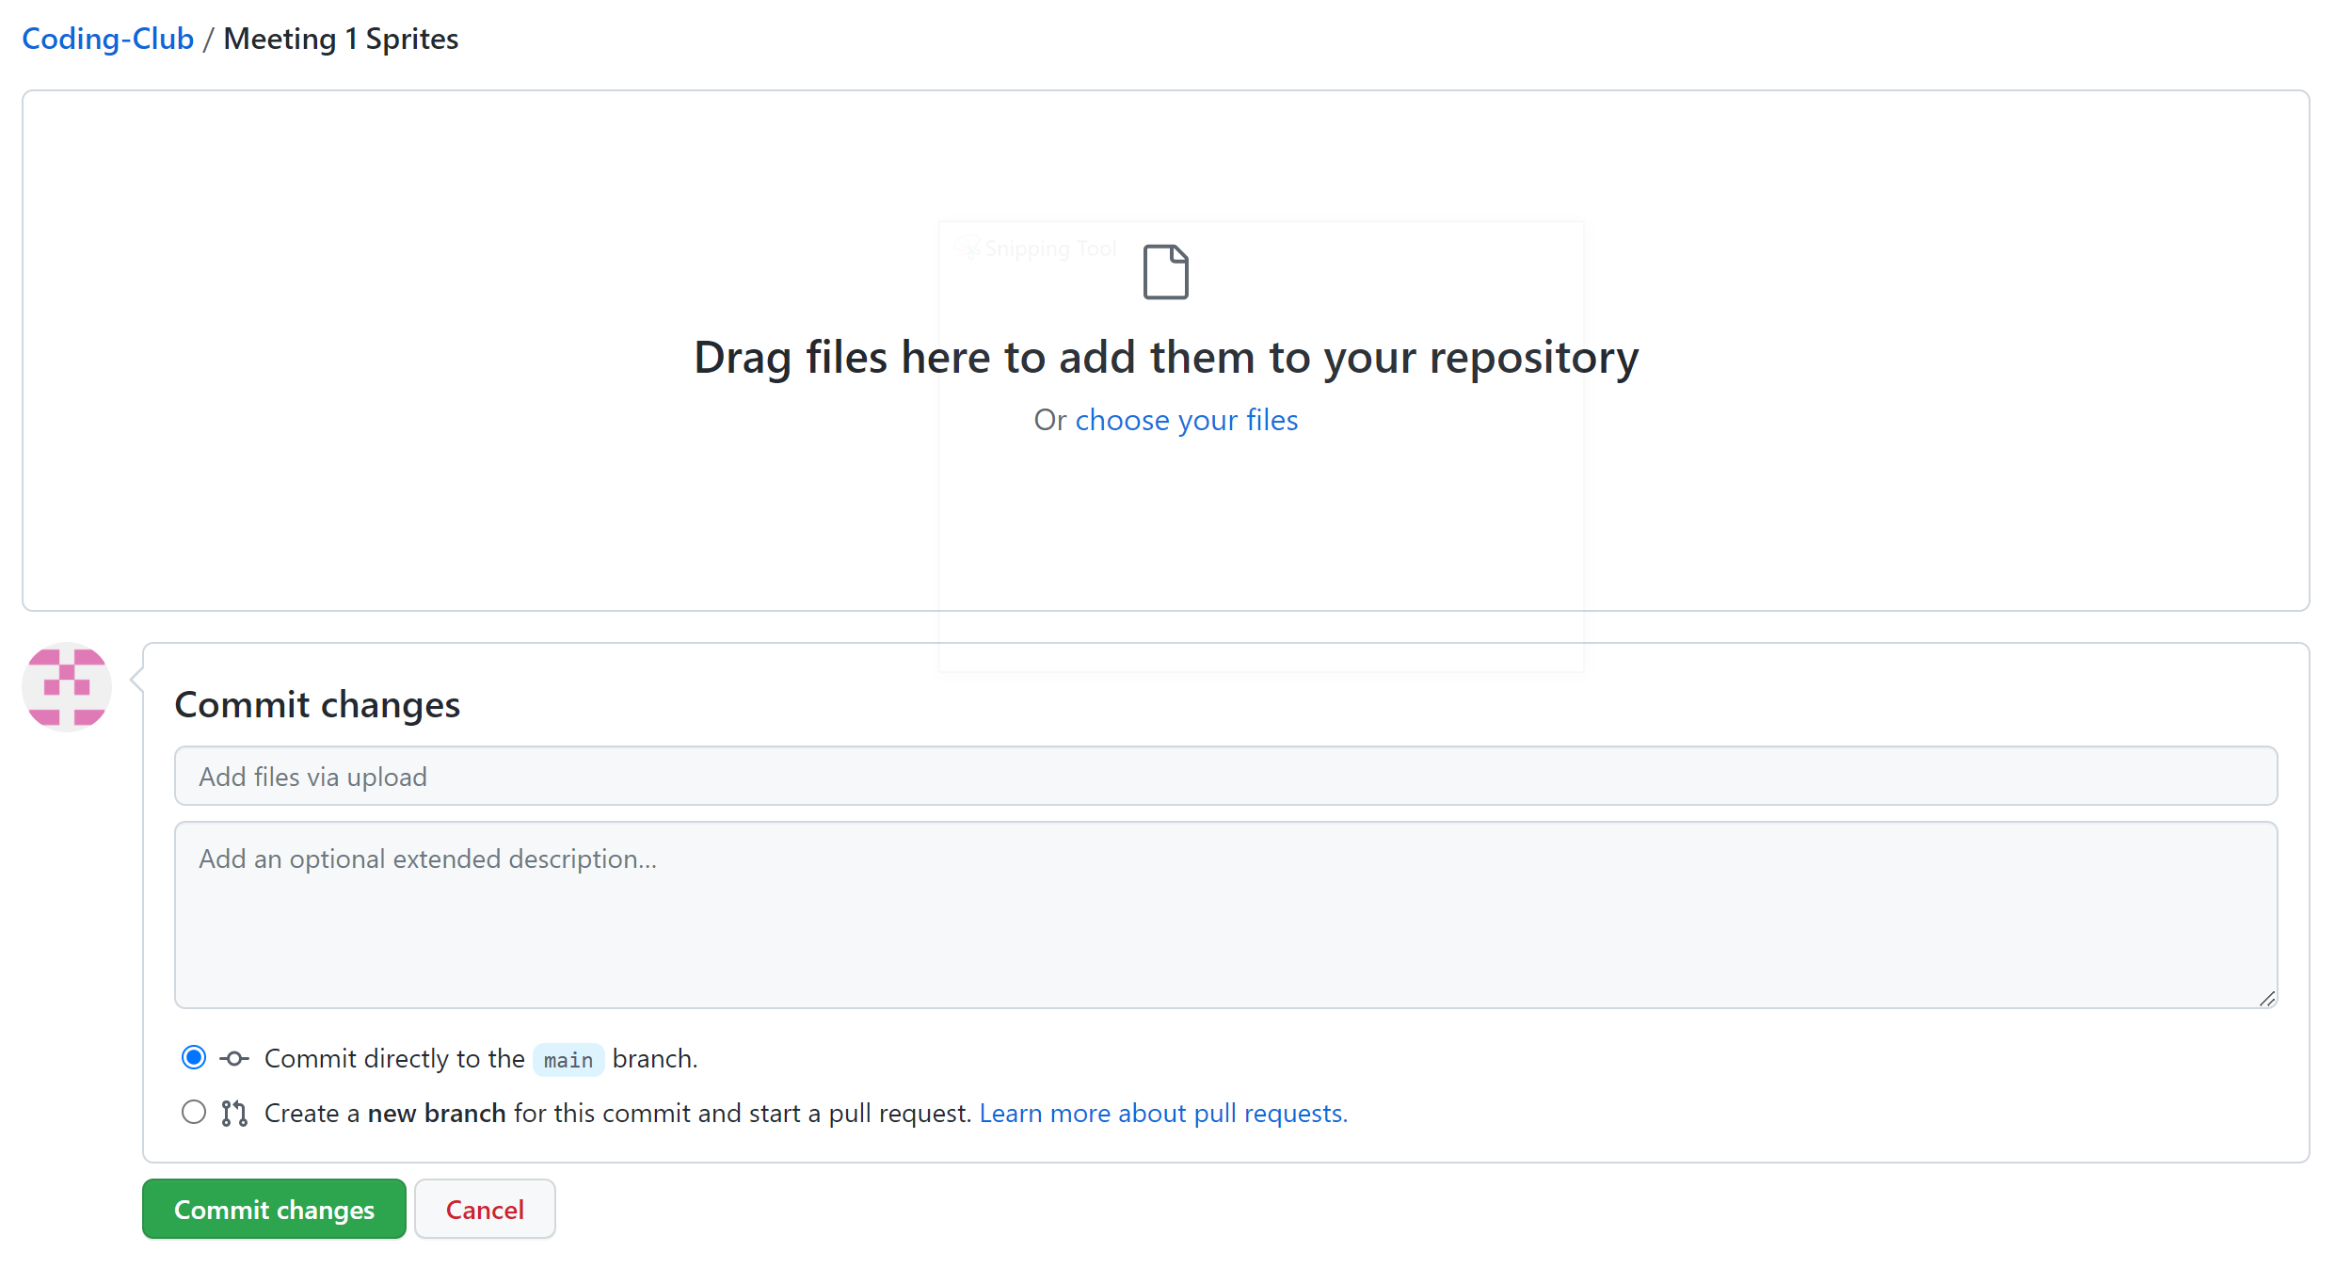
Uploading your Sprite to GitHub
Note: To do this, you must be a collaborator on the Coding Club Repository
With the file saved to your computer, lets put it on the Coding Club Repository To do this, make sure you are a collaborator on GitHub, and then navigate to the “Meeting 1” Folder. Navigate into there, and then select Add File to add a new file.
From here, drag the sprite file into GitHub, and then click commit changes

Slide 17
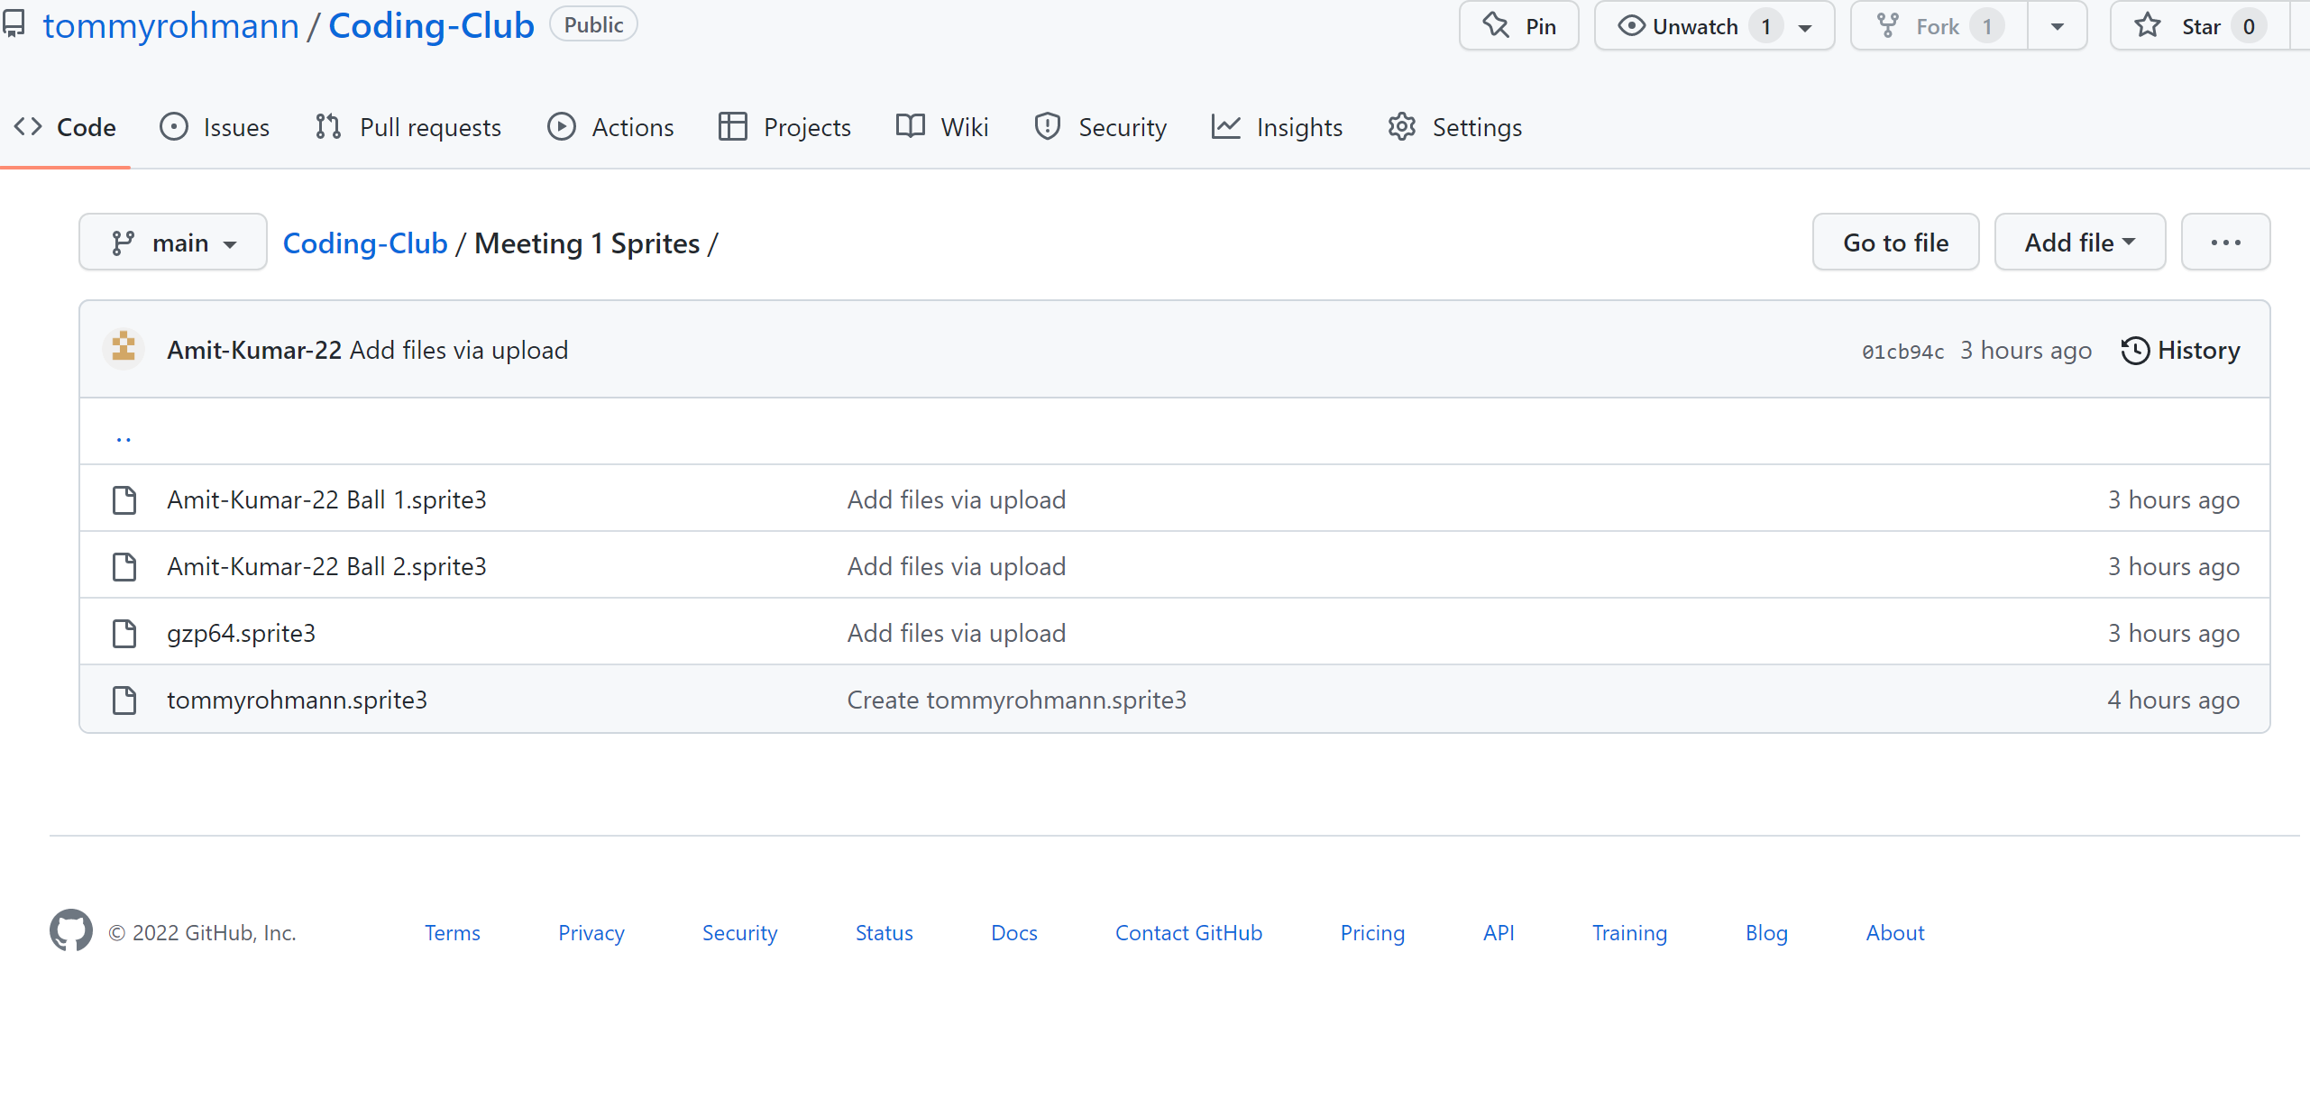
Uploading your Sprite to GitHub
With that, your sprite should now be in the repository. Good job!
You should see your sprite in the folder now

Slide 18
That’s All!
Thank you for coming! Any questions?
If you have any outside the club meeting feel free to send me an email:
Thomasroh.20@sunymaritime.edu

